Slide 1
SMART FARMING USING IOT
TEAM NAME: WARRIORS
TEAM MEMBERS:KOUSIK SAI,HARSHA
THEME: AGRICULTURE

Slide 2
IDEA/PROBLEM STATEMENT
In recent years yield from the agriculture fields was affected by the climate changes due to pollution and global warming etc. Another reason is that still our farmers are practicing conventional practices. To overcome these challenges the solution is green technologies i.e. poly house farming.
To develop a project (Poly House) which will be helpful to farmers in many ways such as due to climatic changes the crop will not get affected and to protect from animals also. Food productivity also increases with this solution.

Slide 3
INTRODUCTION
Poly house farming:
It is a House like structure built of polyethylene or glass which will reflects the UV rays and keep the environment normal inside the Polyhouse.
Polyhouse or a greenhouse is a house or a structure made of translucent material like glass or polyethylene where the plants grow and develop under controlled climatic conditions
Fruits that can be grown are Papaya, Strawberry etc.
Vegetables that can be grown include Cabbage, Bitter Gourd, Capsicum, Radish, Cauliflower, Chili, Coriander, Onion, Spinach, Tomato etc.
Flowers like Carnation, Gerbera, Marigold, Orchid, and Rose can also be easily grown.

Slide 4

IoT
Sensors
People and Processes
Connectivity
IoT

Slide 5
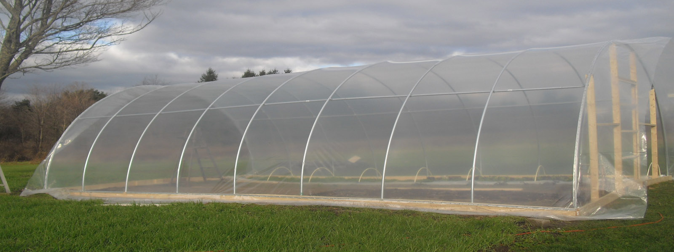
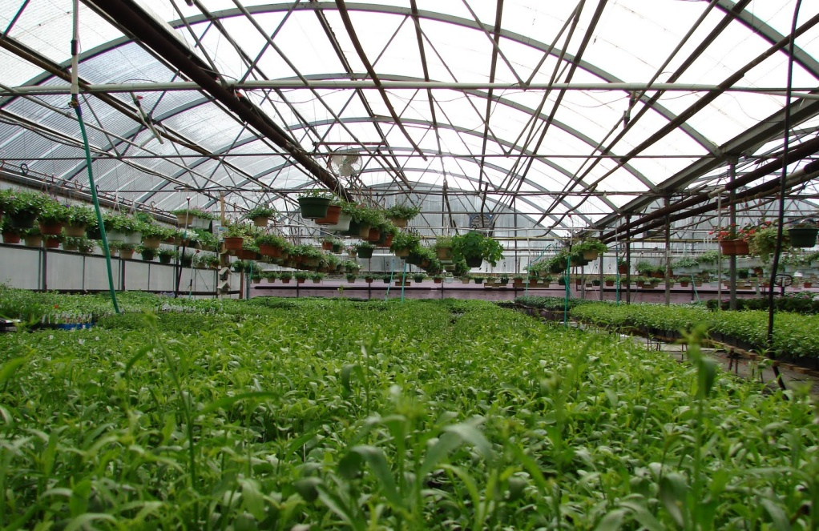
IoT IN POLYHOUSE
Regulate the inside Atmospheric conditions.
Automatically control the Temperature, Humidity, Light, Soil Moisture, Carbon dioxide, Tank level.

Slide 6
PARAMETER SELECTION
S.No | Parameters | Range
1 | Soil Moisture | 10% of whole volume of soil
2 | Humidity | 50%-70%
3 | Temperature | 24⁰c-28⁰c
4 | Light intensity | 25,000-50,000 Lux
5 | Carbon dioxide (Gas) | 300-500 ppm

Slide 7
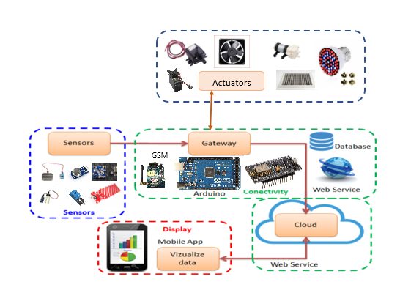
SYSTEM ARCHITECTURE
Three-Tier Architecture

Slide 8
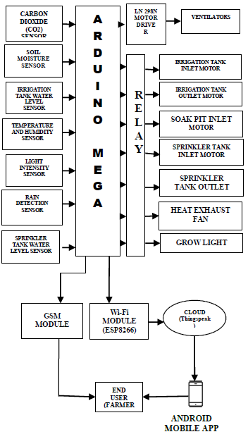
HARDWARE DESIGN

Slide 9
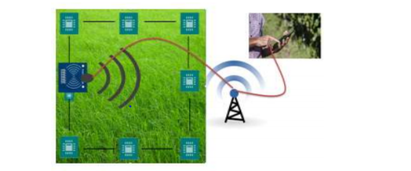
ADDITIONAL FEATURE
INTRUDER DETECTION USING SENSORS

Slide 10
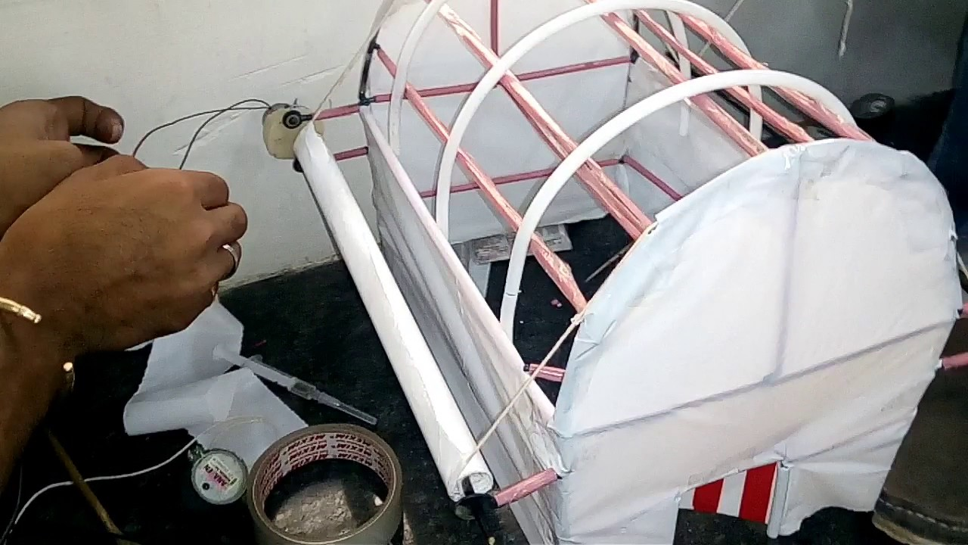
EXPECTED PRODUCT

Slide 11
BENEFITS OF POLYHOUSE FARMING
Polyhouse is very beneficial for the farmers specially those who prefer organic farming. here are few of the benefits of a polyhouse:
1) Your plants are grown under controlled temperature thus there is less chances of crop loss or damage.
2) You can grow crops throughout the year and will not have to wait for any particular season.
3) There are less pests and insects in a polyhouse.
4)External climate will not have any impact of the growth of crops.
5)Quality of produce is obviously higher in polyhouse.
6)Poly House gives the right environmental facilities to your plants in any season.
7)It also increases yield for about 5 to 10 times.
8)Less cropping period
9)Fertilizer application is easier and is controlled automatically with the help of drip irrigation.

Slide 12
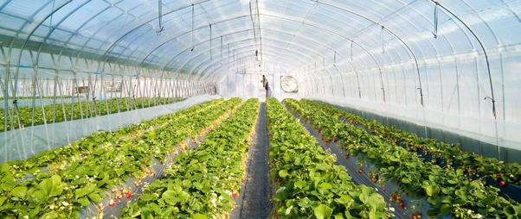
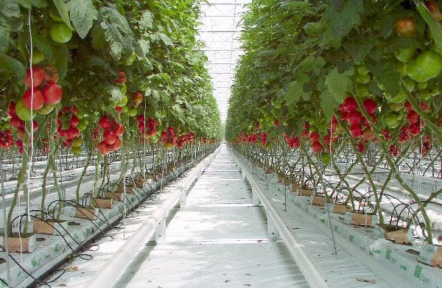
APPLICATIONS

Slide 13
CONCLUSION
Agriculture in INDIA contributes nearly 15-17% of the GDP
By using this project we can use less amount of pesticides and fertilizers which results in high yield of crop productivity.
The Ultimate Goal of IOT is to Automate Human Life.
It has been estimated that the yield under polyhouse or greenhouse farming can be achieved at a higher level – say about 4-8 times as compared to farming done in open field. Hence farmers must think of setting up a polyhouse rather than just working on open fields.

Slide 14
FUTURE EXTENTION
It can be extended for big polyhouses using WSNs.
Farms with open farming can also be monitored using these sensors and IoT for enhancing quality yield, extension of crop cycle, early data collection and processing
Increase in harvest and Profit
It can also be improved by using sensors like soil nitrogen sensors are to be used to know the nitrogen level in soil which will be helpful for growing of the crop.

Slide 15



